Slide 1
Knowledge Partners
Overview of Knowledge Report on
Towards a Food Secure Future
The Pivotal Role of Crop Protection Solutions in Boosting Sustainable Growth of Indian Agriculture

Slide 2
Scope of presentation
Importance of crop protection solutions
Overview of trends in the sector
Industry’s strides towards sustainability
Government initiatives
Challenges & Myths
Key initiatives for boosting crop protection industry’s contribution to sustainable growth and development of Indian agriculture
What should Industry do?
How can policymakers support?

Slide 3
A variety of macrotrends are redefining the ask from Indian agriculture
Increasing population
Increasing urbanization
Shifting dietary pattern
From 1.4 Bn to 1.7 Bn by 2050
From present 31% to nearly 52% by 2050
Meat consumption to be 3 times higher by 2050
Milk demand projected at 401 Mn MT
Declining water resources
Land fragmentation
Decreasing labor availability
Receding groundwater tables
Agriculture water requirement to reach 1072 BCM (1.6 times increase) by 2050
Average land holding estimated to drop to 0.30 ha by 2050
Labor force employed in agriculture in India is expected to decrease from 54.6% in 2011 to 25.7% by 2050
Raising temperatures
Erratic weather patterns
Climate impact on yields
Avg temp increase by 1.3% (in a medium emission pathway) by 2050
increasingly frequent heat waves, droughts/cyclones, vagaries of monsoon
Crop yield estimated to drop by 7.2 to 23.6% by end-century
Sources: https://population.un.org/wpp/Publications/; https://population.un.org/wup/publications/Files/WUP2018-Report.pdf; https://nrcmeat.icar.gov.in/docs/Vision-2050.pdf; https://krishi.icar.gov.in/jspui/bitstream/123456789/1093/1/ciae_vision_2050.pdf; https://www.nabard.org/auth/writereaddata/tender/2010165456All_India_Projected_Water_Demand.pdf; https://wotr.org/2022/06/17/action-points-india-global-land-outlook-report-2022/#:~:text=In%20India%2C%2032%25%20of%20the,et%20al.%2C%202018); https://www.thehindu.com/sci-tech/agriculture/India-losing-5334-million-tonnes-of-soil-annually-due-to-erosion-Govt/article15717073.ece; IFPRI: Global Food Policy Report 2022; https://unfccc.int/sites/default/files/resource/INDIA_%20BUR-3_20.02.2021_High.pdf

Slide 4
Significantly increasing agri-productivity is a mission critical ….
Over the last decade, Indian agriculture has shown significant resilience to these changes ……
…. However, for a food secure future, a transformational jump in productivity coupled with minimising crop loss is mission critical
Productivity has increased across key categories
Productivity Now vs 2050
Cereals yield trends 2010-2020 Tonnes/ha
Fruit yield trends 2010-2020 Tonnes/ha
25%
26%
Foodgrain production
Million MT
Productivity
MT/Ha
400
2010-11
2020-21
2010-11
2020-21
316
Vegetables yield trends 2010-2020 Tonnes/ha
Pulses yield trends 2010-2020 Tonnes/ha
7.09*
7 %
28%
2021-22
2050
4.28
2010-11
2020-21
2010-11
2020-21
Per capita GVA* from agriculture (constant 2011-12 prices), INR/year
31%
Fruits & vegetables production
Million MT
2021-22
2050
650
317
2021-22
2050
2010-11
2015-16
2020-21
*Productivity for 2050 has been calculated by dividing the projected production (foodgrain + fruits & vegetables) of 2050 with the total area under cultivation (foodgrain + fruits & vegetables) now assuming land acreage remains the same
* Per capita GVA has been calculated by dividing the GVA of agriculture (excluding forestry) of the particular year with the total population of the same year
Source: Ministry of Agriculture, MoSPI, ICAR Vision 2050, FAO, YES BANK Analysis

Slide 5
One of the key challenges: Crop yield loss due to pest attack
FAO estimates that annual global crop loss is up to 40%
Crop protection solutions are the defense to these diverse pest attack
In India, estimates indicate annual yield loss of about INR 2 lakh crores
Source: FAO, Technical Bulletin No. 23 ICAR- Directorate of Weed Research

Slide 6
India overview: Crop protection solutions (usage in volume)
Trends in usage volumes
(Tech grade, MT)
Crop wise Share (% volume, 2022-23)
Segment wise share (% volume, 2022-23)
Synthetic agrochemicals
Biopesticides
Cereals
Cash crops
Vegetables
Pulses
India
Oilseeds
Fiber
Fruits
Plantations
Others
Synthetic agrochemicals CAGR (-3.2%)
Global: Weedicides – 52%; Fungicides – 23%; Insecticides – 18%; Others – 7%
Bio pesticides CAGR (0.2%)
Cash crops include – cotton, sugarcane
Fibers include – jute, mesta
Others include – spices, aromatic & medicinal, flowers
Source: Directorate of PPQS, YES BANK Analysis

Slide 7
Usage comparison: India vs Global
Agrochemical use (2021, kg/ha active ingredient)
Source: FAO, active ingredient

Slide 8
India – Emerging as a preferred global manufacturing destination
Top 5 agrochemical exporting countries
(2022, USD Bn)
Indian exports: Key export destinations
(% Share, value terms)
India as the 2nd largest exporter of agrochemicals
Share of India in global
~ 11 %
Source: ITC Trade Map,, WTO
Source: CHEMEXIL export statistics, 2022-23 provisional

Slide 9
Winds of change 10 key trends that the Indian industry is undergoing ..
Transformation in farmer engagement approach
(beyond crop protection)
Emergence of bio-control and hybrid control
Sustainable farming practices : redefining use of crop protection chemicals
Addressing traceability as India emerges as global food hub
1
2
3
4
5
Emergence of Kisan drones as pivotal disruptor
Digital public goods redefining farmer engagements
Fostering Partnerships
with agi-tech startups
and other like minded ecosystem players (food processing companies, FPOs etc)
6
7
India emerging as a preferred destination for manufacturing
Changing dynamics as molecules go off-patent
Pharmaceuticals industry eyeing crop protection for diversification
8
9
10
Source: Stakeholder Discussion, CropLife, YES BANK Analysis

Slide 10
Winds of Change….. Shifts towards sustainable farming
1
2
3
4
Transformation in farmer engagement approach : Beyond crop protection
Emergence of bio-control & hybrid control
Sustainable farming practices : redefining use of crop protection chemicals
Partnering in traceability initiatives to create farmer level awareness to manage residue levels
Rate of application per unit area
1960-70
2000-3000 gm / ha
1980
50-500 gm/ha
1990-2000
25 - 250 gm/ha
2000s
<100 gm/ha
Extension services shifting from “promoting product” to “promoting diversified solutions that increase farmer income”
Services provided include weather information, agronomic advice, market price information, linking farmers to markets, promoting FPO and rural entrepreneurship, women empowerment etc
Strong focus on introducing green chemistry molecules with increased efficiency, reduced application rate, low impact on environment.
Increased focus on bio-products, IPM and hybrid-products (Bio+Synthetic combination products)
Practices such as Direct Seeded rice and Sustainable Sugarcane initiative impacting profile of pests (changing weed profile), requiring different types of crop protection solutions
Traceability to address MRL issues by training farmers on effective pesticide application and IPM practices
Partnerships with food processing companies to promote safety, quality and traceability in agri-commodities
Partners in initiatives such as Gape.net and Basmati.net
Source: Stakeholder Discussion, CropLife, YES BANK Analysis

Slide 11
Winds of Change….. Embracing technology and digitisation
5
6
7
Fostering Partnerships
with agri-tech startups
and other like minded ecosystem players
Emergence of Kisan drones as pivotal disruptor
Digital public goods redefining farmer & channel partner engagements
Equipping farmers with modern tech-enabled services by integrating technologies such s remote sensing, drone tech, robotics, precision agriculture etc
Partnering with agritechs to facilitate advisory services, direct-to-farmer supply as well as facilitate linking farmers to markets
FMC+Niqo robotics
Bayer+ Agrostar; Syngenta + NinjaCart
Could change the way crop protection chemicals are applied.
Strong government support: PLI, AIF, Lakhpati Didi scheme promoting women entrepreneurs to take up drone piloting
Drone companies working with crop protection companies to aggregate spraying demand hours and passing to rural drone operators
Rallis+Garuda Aerospace, Dhanuka+ IoTech Aviation
Agristack as part of India Digital Ecosystem for Agriculture (IDEA)
eNAM platform ; ONDC
Use of GEM (Government Electronic Marketplace) for institutional purchase of agrochemicals
TReDS and other innovative financing models
Source: Stakeholder Discussion, CropLife, YES BANK Analysis

Slide 12
Winds of Change….. Industry megatrends
8
9
10
India emerging as a preferred destination for manufacturing of agrochemicals for the world
Focus on off-patent molecules opportunity
Pharmaceuticals industry actively exploring crop protection sector for diversification
India as a reliable alternative for agrochemical manufacturing (China+1)
Progressive policy environment, availability of established chemical manufacturing capabilities, strong R&D capability, skilled workforce, efficient backward integration (pyrethroids, pyridines etc), cost competitiveness
Strong competition from Vietnam, South Korea, Malaysia and Philippines
By 2030, 22 additional crop protection products will go off-patent
India’s strong research and manufacturing capability coupled with cost competitiveness could be utilized to introduce these molecules into the country.
This will provide more diverse and efficient crop protection options to Indian farmers.
Leveraging scientific acumen and research capabilities to develop innovative crop protection solutions
Mankind Pharma – Mankind Agritech; NATCO Pharma – Crop Science Division focused on biological pest management and plant growth stimulants
Source: Stakeholder Discussion, CropLife, YES BANK Analysis

Slide 13
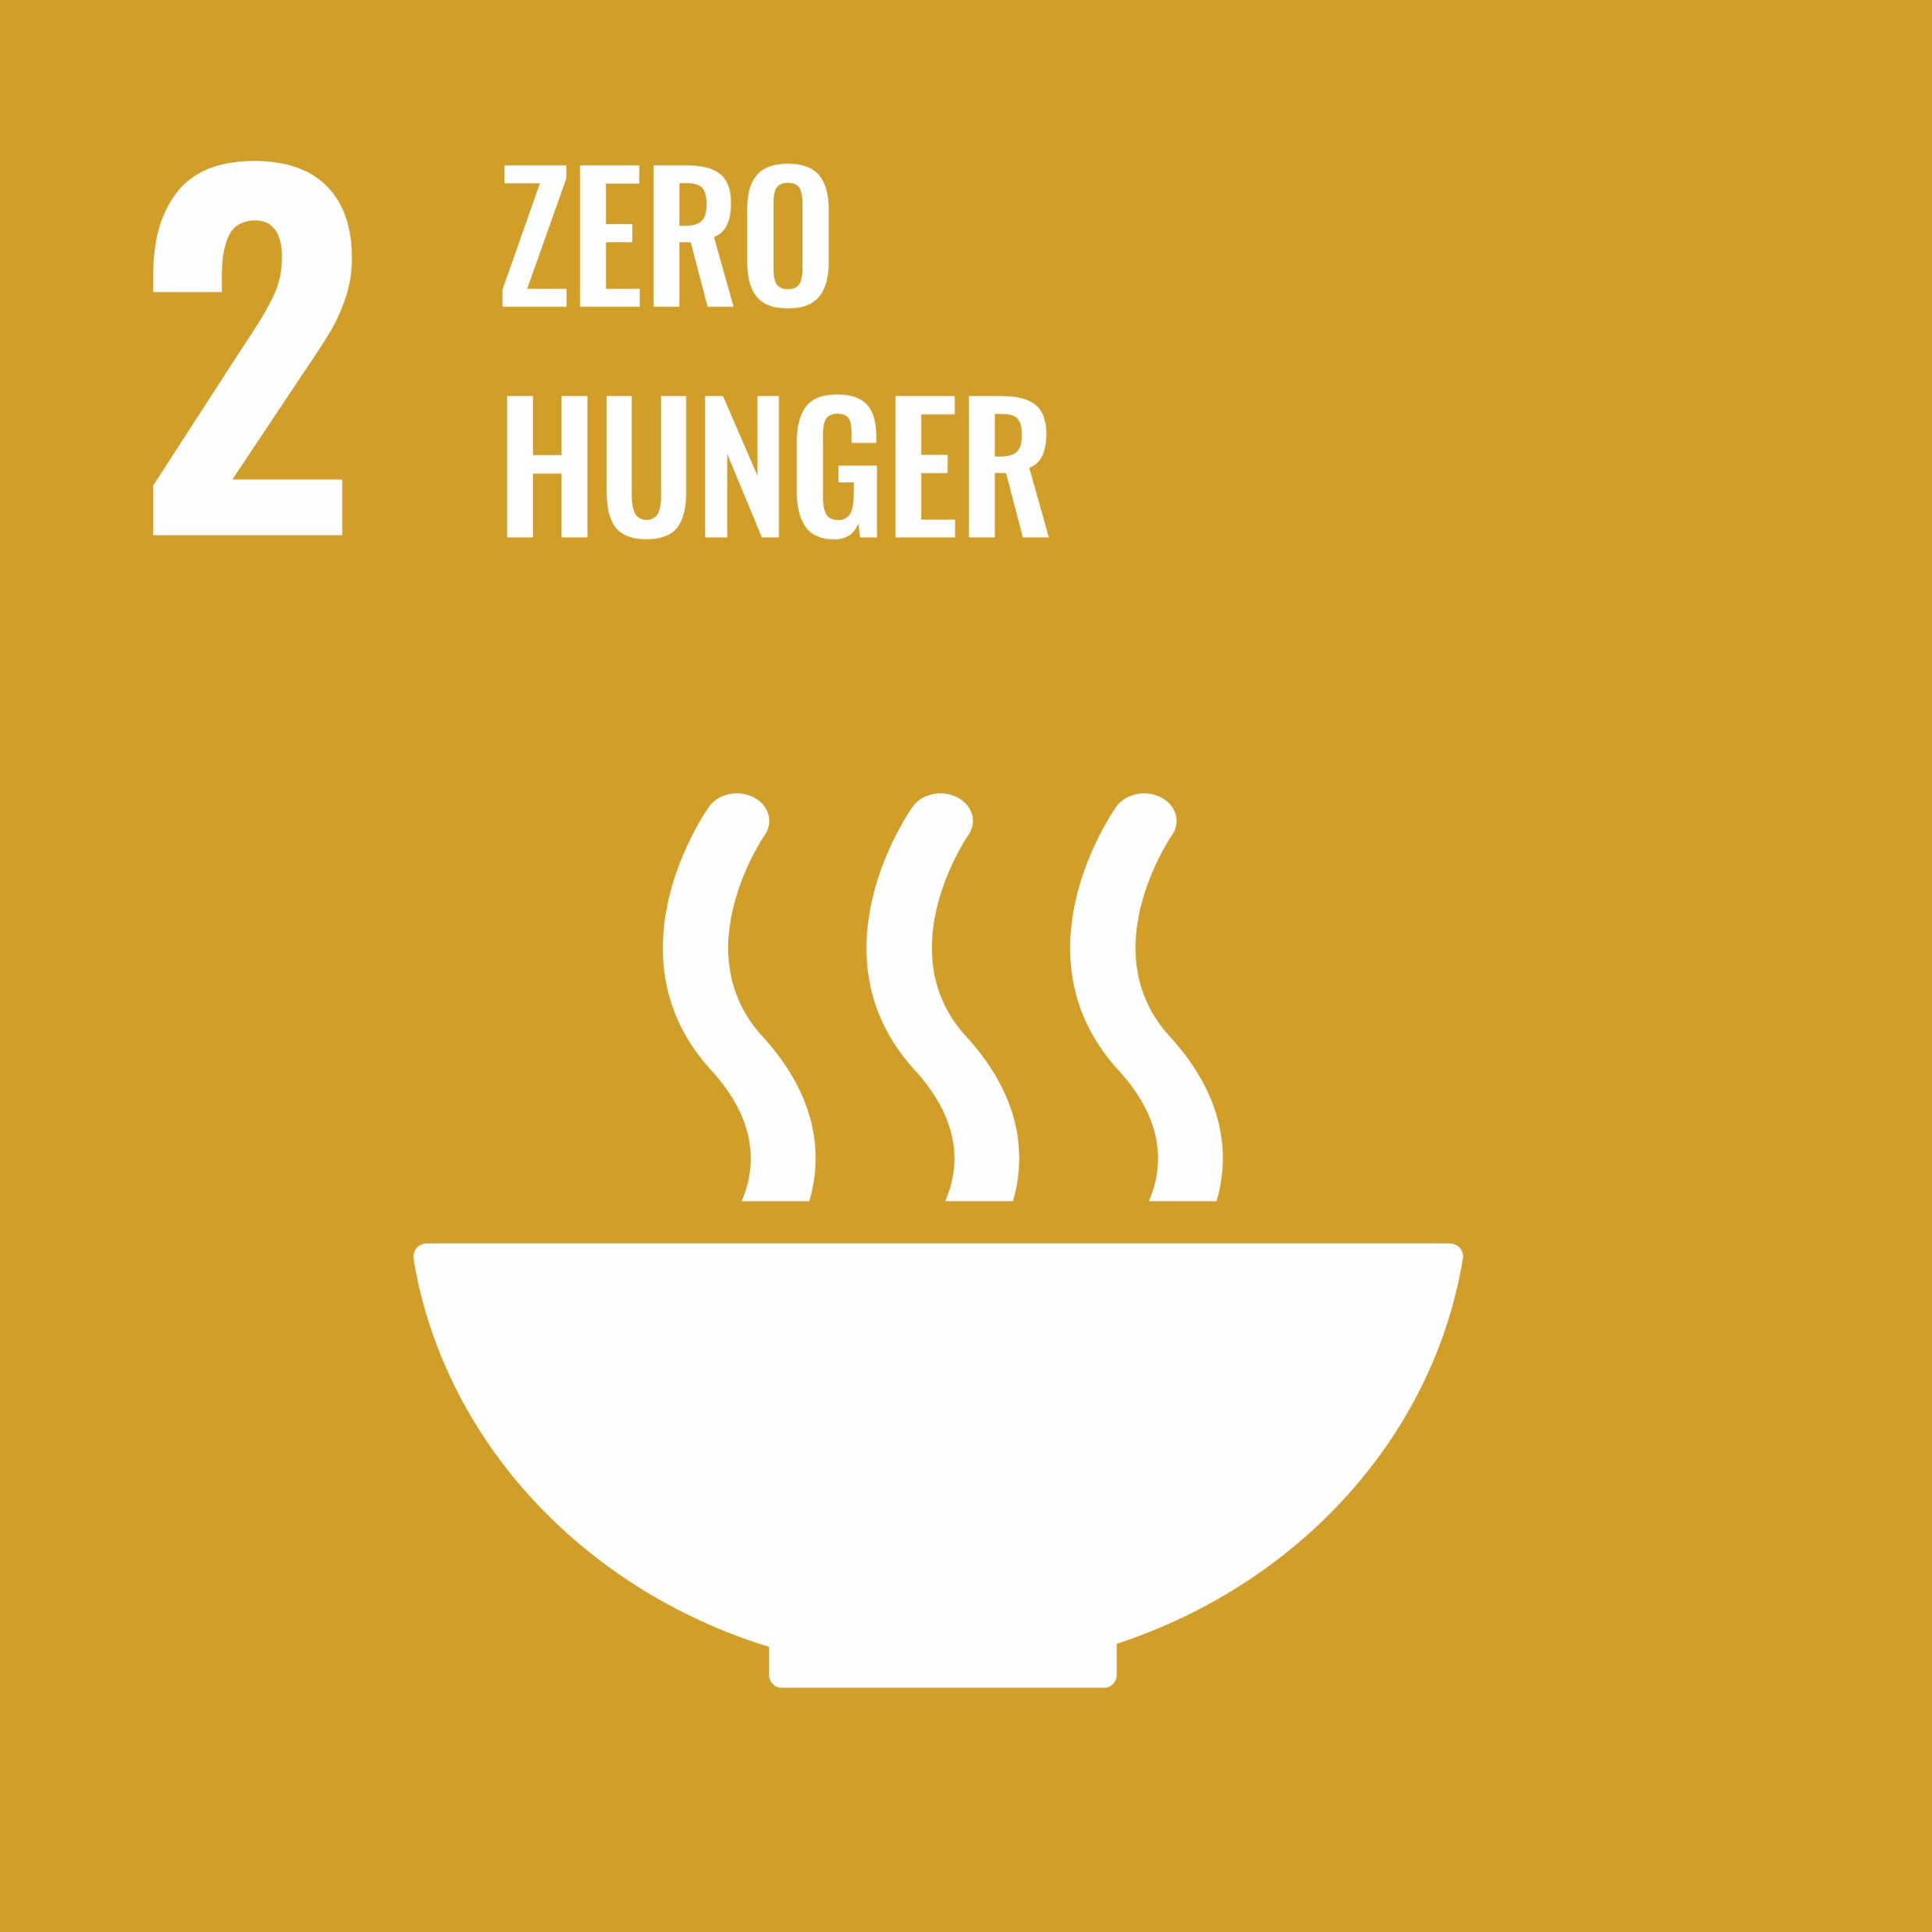
Crop protection industry’s strides towards sustainability
Farmer income enhancement
Conservation of natural resources
Increasing crop yields
Linking farmers to markets for better price realization
Supporting formation of FPOs
Rural entrepreneurship programs
Encouraging conservative agriculture practices
Soil care programs
Water conservation
Integrated pest management
Climate action – reducing emissions
Improving quality of life
Encouraging climate smart farming practices
Aiding farmers in mitigating GHG emissions
Enhancing biodiversity
Utilizing renewable sourcing of energy
Safe, & healthy working environment
Reducing and recycling of plastic waste
Women empowerment
Centre of excellence & learning centers for knowledge transfer
Source: Stakeholder Discussions, CropLife, YES BANK Analysis

Slide 14
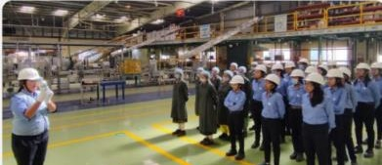
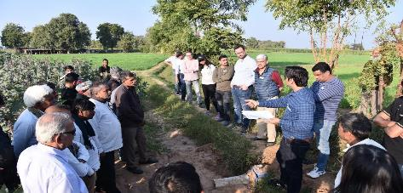
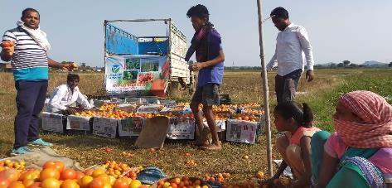
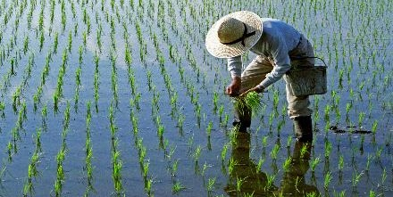
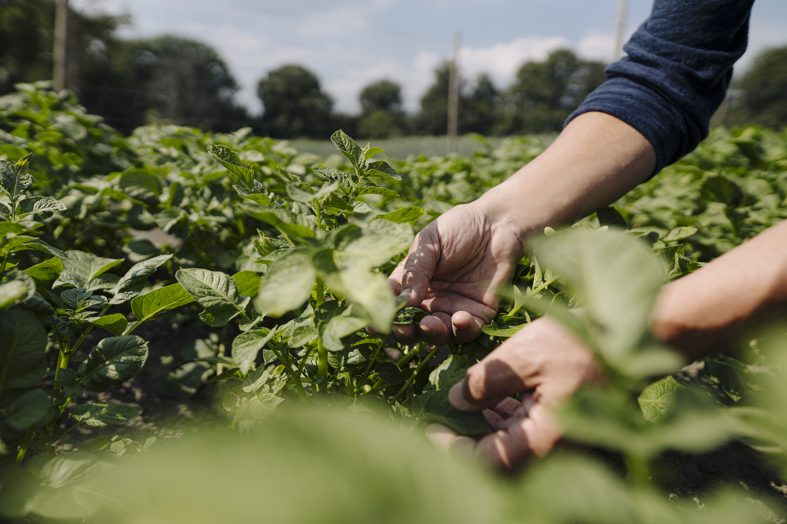
Case studies: select sustainability initiatives
1. ADAMA
2. BASF
3. Bayer
4. Bharat Certis
Green chemistry & gender diversity
Project Pragati
Better Life Farming
Driving rural prosperity
Moving towards greener chemistry
Soil health
Gender diversity
Sustainable castor production
> 19000 Ha, 6,200 SHF covered
Yield increase: 22%, water saving
Sustainability Cert. & sourcing
Increase yields & price through access to inputs and markets
2X Yield & 3X income in green chilli-UP, Tomato- Uttarakhand
Adopted villages in MP, UP and Haryana
GAP, Safe use of agrochemicals
Villager healthcare, child education
5. Corteva
6. Crystal
7. Dhanuka
8. FMC
Climate Positive Leaders Program
Committed to serve farmers
Transforming India through Agriculture
Science Driven People Focused Solutions for Agriculture
Honors farmers who made measurable impact in climate positive agriculture
Empowering rural women
Agri-care programs: Good agricultural practices training programs
Dhanuka Kheti Ki Nai Takneek – minimum loss maximum yield
Gaon Ki Pani Gaon Mein aur Khet Ki Pani Khet Mein
Plastic recycling program
Drone spraying services
Pesticide safety awareness
Women empowerment

Slide 15
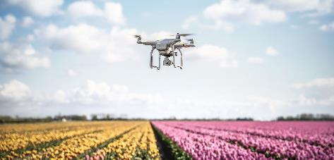
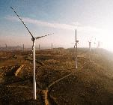
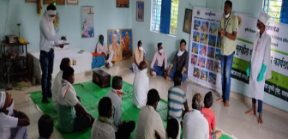
Case studies: select sustainability initiatives
9. Indofil
10. Nisso
11. Pesticides India
12. Rallis
Sowing the seed of sustainability
Contribute to sustainable growth
Sustainable value creation for people and planet
Moving towards a circular economy
“Crop care concept” in select crop districts – needs and problems are identified, and solutions provided
Access to Safe, sustainable and effective plant protection solutions
World class technology
Focuses on protecting the health and safety of people while continuing to support commitments towards SDG goals
Initiatives to scale-up drone technology penetration
Standardisation of protocols and validation of efficacy across crops
13. Stains
14. Sumitomo
15. SWAL
16. Syngenta
Giving back to society
Paving the way to greener future
Strides towards ecological farming
Promoting Sustainable Agriculture and Rural Prosperity
Carries out programs that empower rural poor
Skill development, infrastructure development, healthcare, education
Resilient sustainability models such as renewable energy, plastic waste management and vermicomposte-water treatment for reducing GHG
Launched a cost effective, sustainable, ecologically safe, innovative solution specially designed for soybean and cotton.
I-CLEAN: Holistic infrastructure in rural vegetable markets
I-SAFE and SoilCare Programs

Slide 16
Government initiatives
Agriculture Infrastructure Related
Empowering Women
Agriculture Infrastructure Fund (AIF), Rashtriya Krishi Vikas Yojana (RKVY)
Lakhpati Didi Scheme
KISAN DRONES PLI / Agriculture Infrastructure Fund (AIF) for Drones
Soil Management
Holistic growth of the Horticulture sector
Soil Health Card
Mission for Integrated Development of Horticulture
Schemes of Government of India in Agriculture Sector
Mechanization
Sub - Mission on Agricultural Mechanization (SMAM)
Agriculture Marketing
Irrigation
Integrated Scheme for Agriculture Marketing (ISAM), E-NAM
Pradhan Mantri Krishi Sinchayee Yojana
Foodgrains
Agriculture Insurance
National Food Security Mission (NFSM)
Pradhan Mantri Fasal Bima Yojana (PMFBY), Weather Based Crop Insurance Scheme (WBCIS)
Source: Various government websites, YES BANK Analysis

Slide 17
Challenges
Low number of registered molecules leading to limited choices for diverse pests
Varying levels of awareness amongst the farmers on appropriate use
Labor shortage hinders timely application of crop protection solutions
Farm level
Cost and time involved in developing new molecules is highp.
INR 2,000 crore of investment in R&D & over 10-12 years for commercialization
Product level
Lack of accurate ground level information on crop area, potential pest attack etc.
Balancing supply during short windows of demand.
Risk of improper storage & handling practices in the remote locations
Supply chain
Registration process for new products is complex and time consuming.
Central license is not valid for the state. State specific licensing.
Lack of Data Protection Rights (DPR) impact introduction of new molecules
Adhoc Bans on crop protection solutions
Regulatory
Source: Stakeholder Discussions, CropLife, YES BANK Analysis

Slide 18
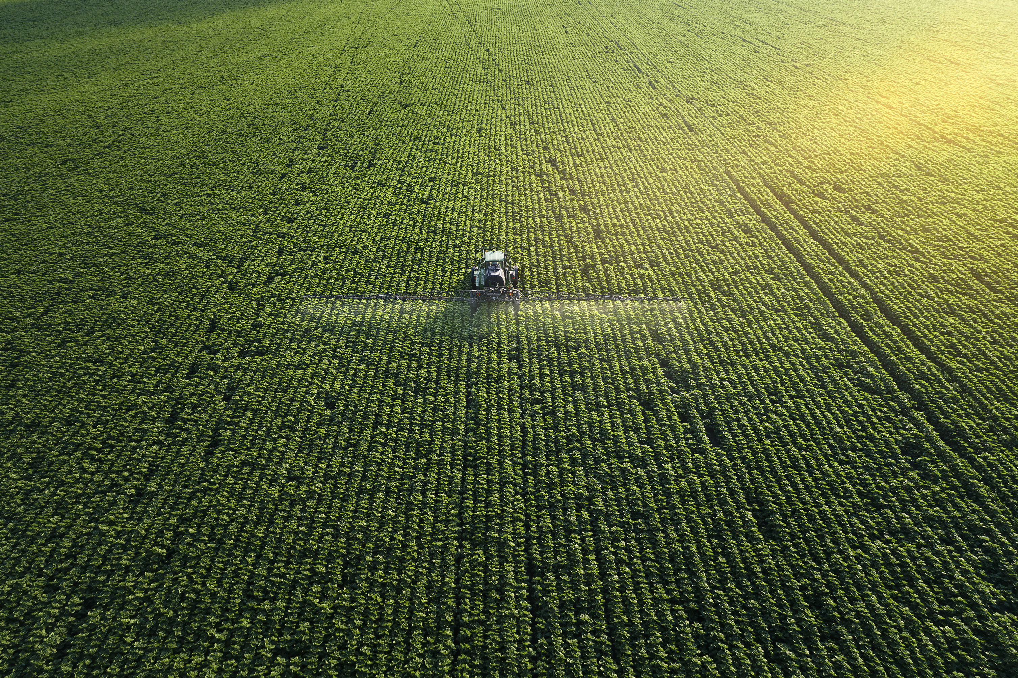
Myths vs actuality
Usage: 0.37 kg/Ha vs global average of 2.7 kg / Ha
Organic farming often warrants use of natural pesticides, which are also chemicals.
All pesticides (organic, bio or synthetic) undergo toxicity, safety & efficacy assessments before commercial use
Agrochemical usage in India is very high
All agri commodities in India carry high pesticide residues
98% of India’s agri commodities have MRL values within the prescribed levels
All India Network Project on Pesticide Residues study
Organic means chemical free
Modern crop protection products are rigorously & regularly tested for safety & environmental impact
Chemical use always harms environment
Use of pesticides limit exports
Top food & agri exporting nations are also the largest consumers of agrochemicals.
Agrochemical industry only focusses on synthetic solutions
India has high number of agrochemicals registered
India has ~330 registered pesticides as against 681 in China, 583 in Japan, 561 in Australia, 481 in USA and 477 in Brazil
Need for new pesticides is triggered by the ever-evolving nature of pests and crop diseases.
The industry offers a variety of products including organic, bio and synthetic
Pesticides are generic chemicals that anyone can manufacture
Development of a new molecule
INR 2,000 crore investment in R&D; 10-12 years for commercialization
Source:FAOSTAT, AICRP-ICAR study, PPQS, Stakeholder Discussions, CropLifne India-YES BANK Analysis

Slide 19
Initiatives for boosting crop protection industry’s contribution towards sustainable growth of Indian agriculture

Slide 20
Boosting contribution to sustainable growth - What should Industry do?
Continue promoting farmer income enhancement solutions (beyond crop protection)
Work with FPOs and ecosystem partners to train farmers on GAP, climate resilience etc
Provide farmers support (inputs and crop selection, accesses to finance, market linkages etc)
Digitally enabled advisory to help farmers make better decisions (climate risks, market prices etc)
Invest in Research & Development to introduce innovative climate resilient crop protection solutions
Green chemistry, climate resilience, productivity improvement
Partnerships with public research institutions
Continue leveraging partnerships for providing cutting edge solutions to farmers, promoting traceability and other such initiatives
Continue co-creating with public sector institutions and agri-tech startups to accelerate adoption of tech-enabled solutions that improve access to inputs, increase farm operations efficiency, link farmers to markets and improve farmer income
Partnerships with Food Processors and government entities for promoting traceability and creating farmer level awareness on MRLs and the need for proper agrochemical application management.
Embrace sustainability as a core value
Orient product development and business operations towards positive social and environmental impact
Contribute to net-zero aspirations through agriculture (afforestation, carbon sequestration, development of carbon credit system for farmers to earn credits)
Source:Stakeholder Discussions, CropLife India-YES BANK Analysis

Slide 21
How can policymakers support?
Continue investing in public digital infrastructure
Continue thrust on use of digital technology in agriculture to increase access, availability and efficient use of agricultural inputs
Build digital infrastructure to facilitate access to robust farm and farmer information database (Agristack) and weather information to enable data driven forecasting and farmer engagement planning
Encourage multi-stakeholder PPP partnerships for extension services, capacity building and awareness campaigns
Develop multi-stakeholder co-creation and co-implementation consortiums for boosting extension focused on sustainable farmer income enhancement
Support industry to create an awareness campaign to educate stakeholders on the contributions and actualities of crop protection solutions
Incentivise private investments to unlock the “global agrochemical manufacturing hub” opportunity
Incentivise companies to produce raw material and intermediaries that are utilized by crop protection solution manufacturers (which are otherwise imported)
PLI for Agrochemicals sector
Enable ease of doing business
Create a single window system for applying and granting licenses across states
Review the process and timelines required for registration of new molecules and align them with international norms while ensuring safety, efficacy and sustainability.
Create enabling policy environment for introduction of new molecules by benchmarking Data Protection Rights being implemented in other countries and appropriately introducing them to India.
Decriminalization of offences under the Pesticide Management Bill 2020
Source:Stakeholder Discussions, CropLife India-YES BANK Analysis

Slide 22
Thank you …

Slide 23
Disclaimer
In the preparation of the material/information contained in this document, YES Bank Limited (“YES Bank”) has used information that is publicly available, including information developed in-house. Information gathered and material used in this document is believed to have been obtained from reliable sources. However, YES Bank makes no warranty, representation or undertaking whether expressed or implied, nor does it assume any legal liability, whether direct or indirect, or responsibility for the accuracy, completeness, or usefulness of any information in this document.
The material or information in this document includes external data sources or references to third party, which are outside the realm or control of YES Bank. YES Bank takes no responsibility for the contents of those external data sources or such third party references. No third party will assume, whether direct or indirect liability whose references have been provided in this document. It is the responsibility of the user or recipient of this document to make his/her own decisions about the accuracy, currency, reliability and correctness of information found in this document.
The opinion or expression made by YES Bank in this document, should not in any manner, be construed as a solicitation or endorsement for any offer for purchase, sale or any financial transaction/commodities/products of any financial instrument referred therein. . All recipients of this document should carefully read, understand and investigate (either with or without professional advisors) into the risks arising out of or attached to such financial instrument or transaction or commodities or products before dealing with them. All dealing or transaction entered upon by such recipients shall be entirely at their own risk and YES Bank shall not be responsible or liable for the same in any way whatsoever.
We have included statements/opinions/recommendations in this document which contain words or phrases such as "will", "expect“ "should“ “estimated” and similar expressions or variations of such expressions, that are or may be construed as “forward looking statements”. Actual results may differ materially and substantially from those suggested by such forward looking statements. Such difference may arise due to various risks or uncertainties associated without expectations with respect to, but not limited to, exposure to market risks, general economic and political conditions in India and other countries globally, which have an impact on our services and / or investments, the monetary and interest policies of India, inflation, deflation, unanticipated turbulence in interest rates, foreign exchange rates, equity prices or other rates or prices, the performance of the financial markets in India and globally, changes in domestic and foreign laws, regulations and taxes and changes in competition in the industry. By their nature, certain market risk disclosures are only estimates and could be materially different from what actually occurs in the future. As a result, actual future gains or losses could materially differ from those that have been estimated.
Neither YES Bank nor any of its officer's directors, personnel and employees, shall be liable for any loss, damage of any nature, including but not limited to direct, indirect, punitive, special, exemplary, and consequential, as also any loss of profit in any way arising from the use of this material or the information therein, in any manner.
The investments discussed in this material may not be suitable for all investors. Any person subscribing to or investigating in any product/financial instruments should do so on the basis of and after verifying the terms attached to such product/financial instrument, entirely at their own risk and costs. Financial products and instruments are subject to market risks and yields may fluctuate depending on various factors affecting the capital/debt markets. Please note that past performance of the financial products and instruments does not necessarily indicate the future prospects and performance thereof. YES Bank or its officers, directors, personnel and employees, including persons involved in the preparation or issuance of this material may; (a) from time to time, have long or short positions in, and buy or sell the securities mentioned herein and/or (b) be engaged in any other transaction involving such securities and earn brokerage or other compensation in the financial instruments/products/commodities discussed herein or act as advisor or lender / borrower in respect of such securities/financial instruments/products/commodities or have other potential conflict of interest with respect to any recommendation and related information and opinions.
No part of this material may be duplicated or copied in whole or in part in any form and or redistributed without the prior written consent of YES Bank. Any other reproduction, adaptation, distribution, dissemination or making available of the information available within this documents for commercial use is strictly prohibited unless prior written authorization is obtained from YES Bank. This material is strictly confidential and privileged to the recipient. It is for use by the recipient only. If you are not a recipient of if this document is sent to you in error, please let us know by return of this document.

